Slide 1
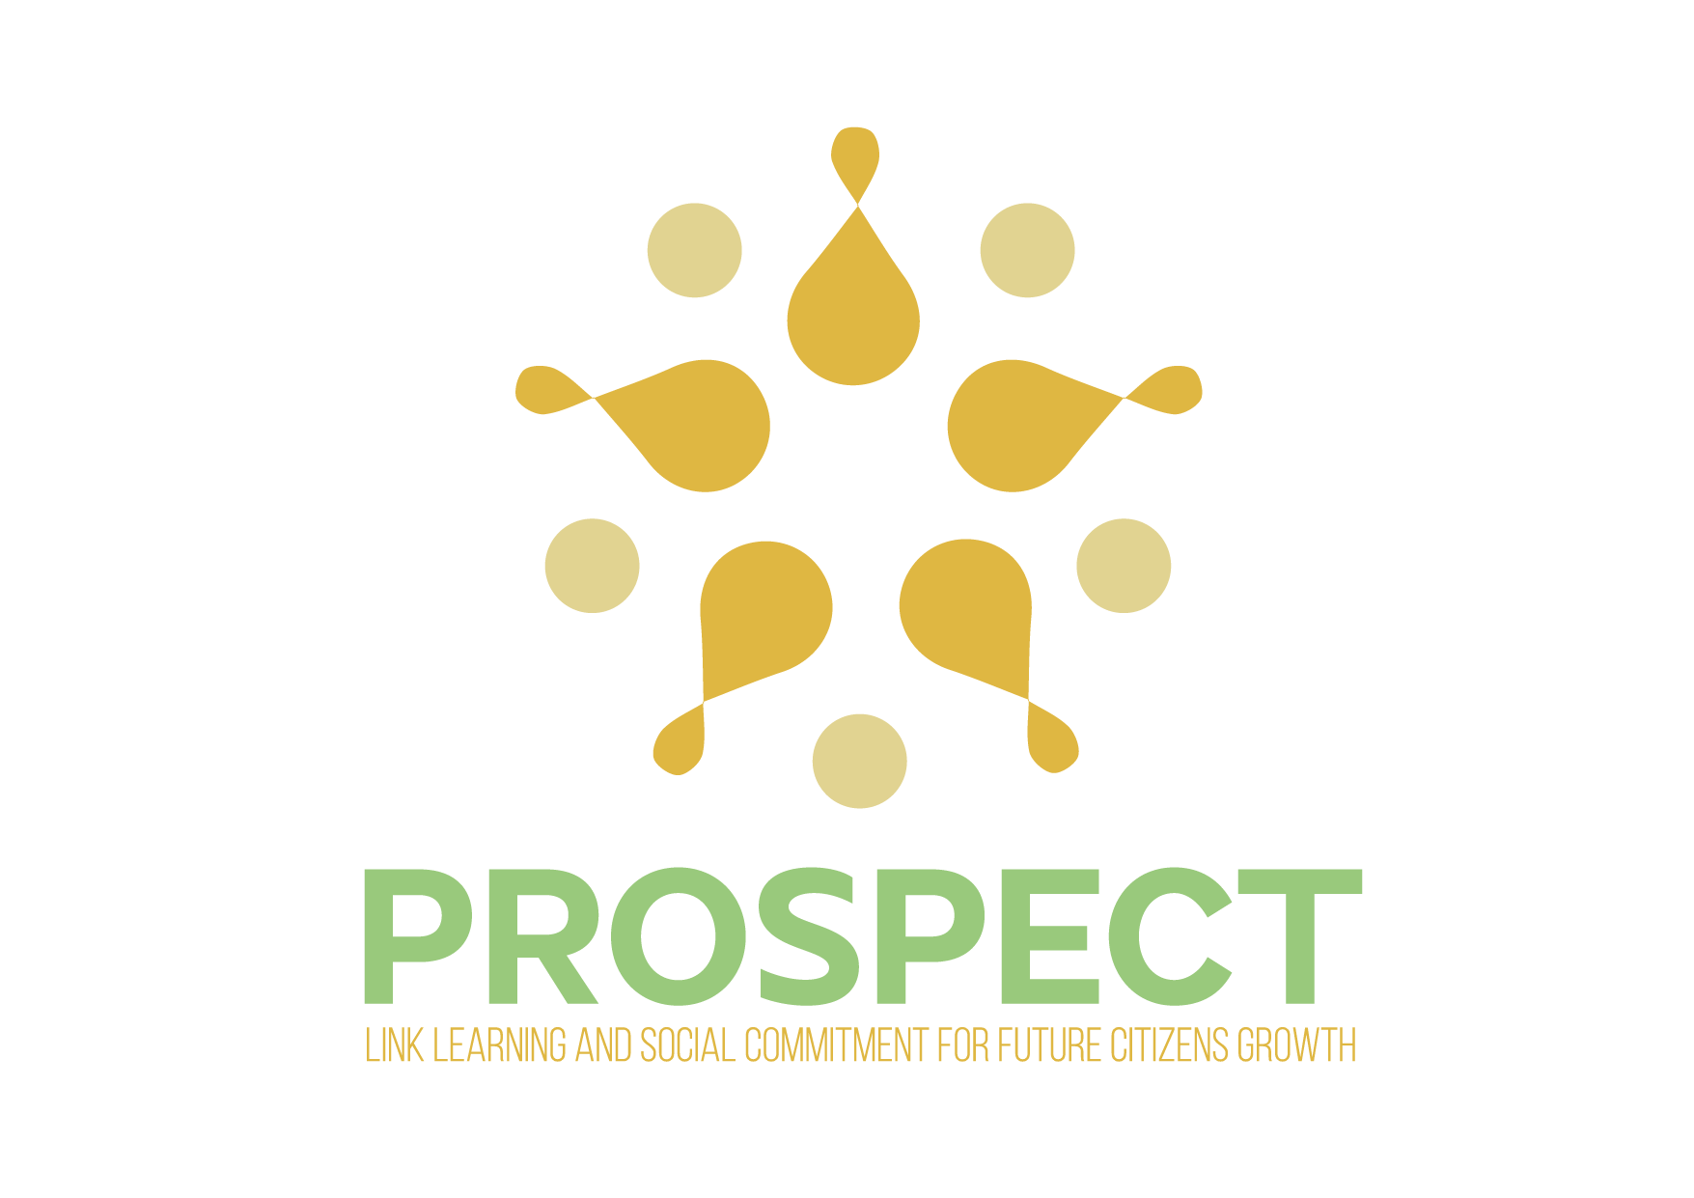
PROSPECT - LINK LEARNING AND SOCIAL COMMITMENT FOR FUTURE CITIZENS GROWTH PROJECT OVERVIEW
TRAINING FOR TRAINERS
28TH JANUARY 2021
RESPONSIBLE PARTNER: DIREZIONE DIDATTICA SECONDO CIRCOLO PERUGIA
ALESSANDRA SCHIPPA - ALBERTO TURELLI

Slide 3
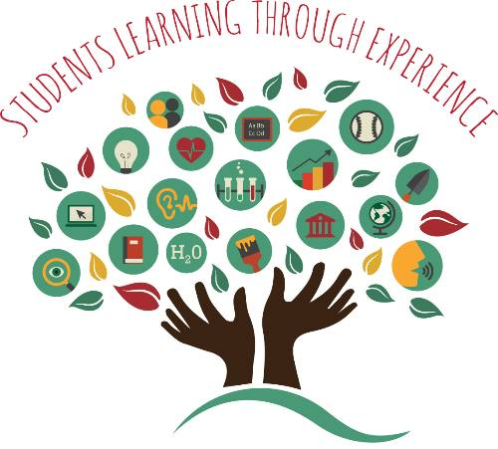
WHAT’S SERVICE LEARNING?
Service Learning is a process of connecting student’s learning to needs in their community,
pairing students knowledge with real world applications,
applying what they learn in real situations while they are involved,
serving and helping the community.

Slide 4
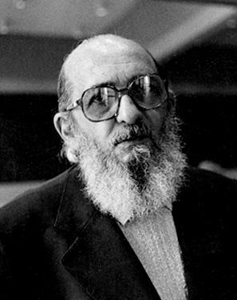
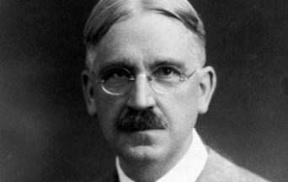
The pedagogical origins of Service Learning can be discovered in John Dewey and Paulo Freire. Both believed that education was not a passive accumulation of knowledge but education was a human empowerment process and the key to democracy.

Slide 5
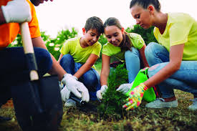
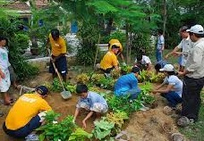
PEDAGOGICAL REVOLUTION
develops curricular learning and social skills through the search for solutions in a reciprocal dialogue between classroom and reality.

Slide 6
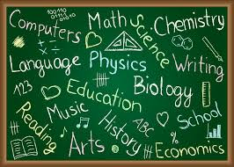
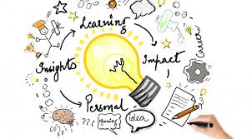
Subjects interact and collaborate to solve problems through learning on a cognitive, affective and cultural level in a circular dimension of solidarity in which students, through an educational negotiation, become protagonists of their learning and social change.

Slide 7
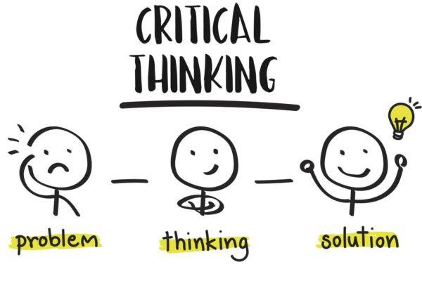
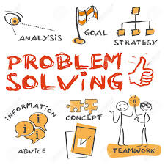
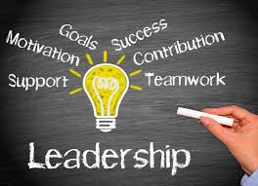
SERVICE LEARNING
creates opportunities for critical thinking, problem-solving
develops communication and leadership skills

Slide 8
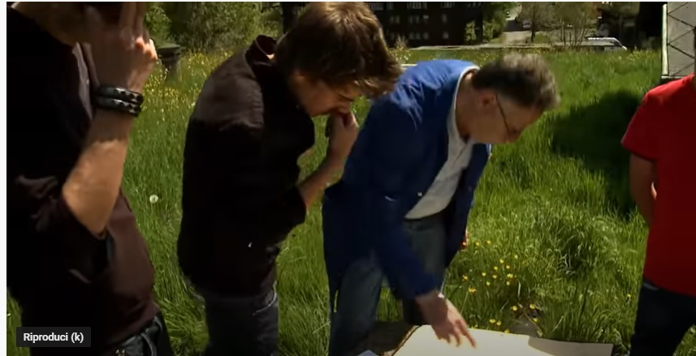
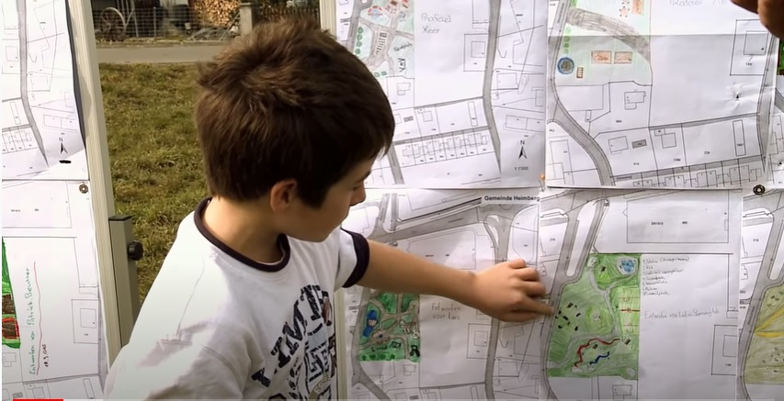
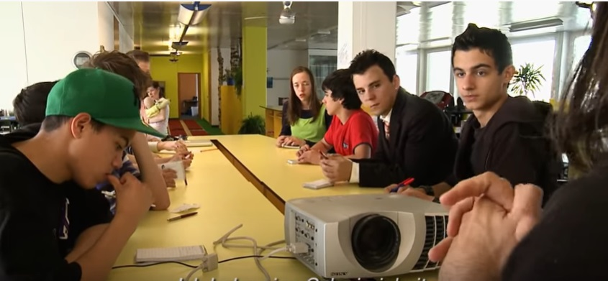
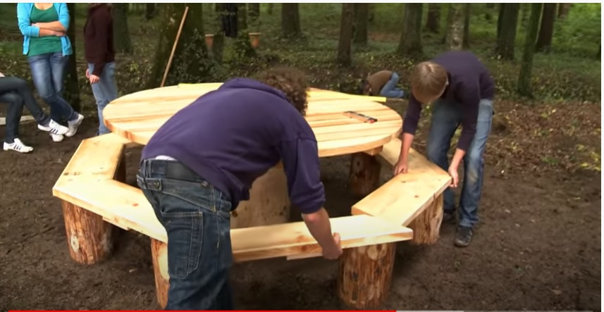
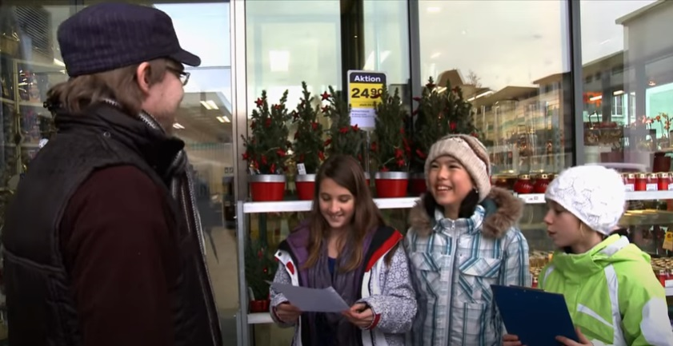
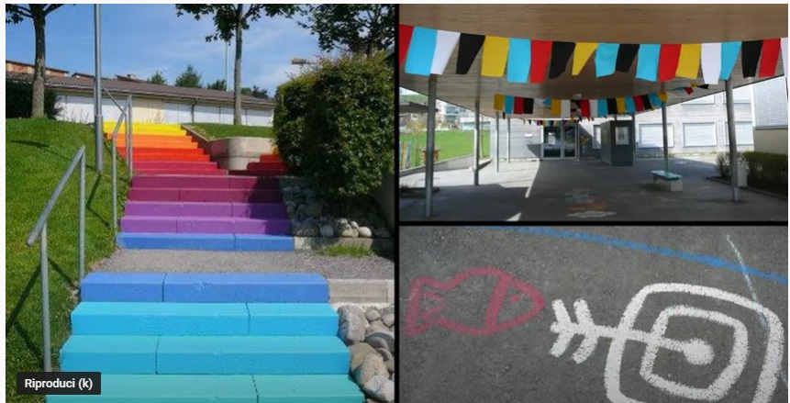
It aims to connect what students are learning inside the classroom with what is happening outside the classroom and in their community in order to meet a need.

Slide 9
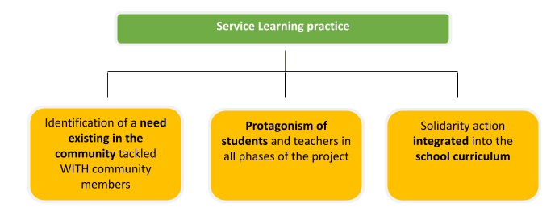
WHAT ARE THE ELEMENTS THAT CHARACTERISE S.L. APPROACH?

Slide 10
Transformative
Empowering
Research-oriented
SERVICE LEARNING
Participatory
Curricular
Collaborative
Competency-focused
Interdisciplinary

Slide 11
"LEARNING SERVES, SERVING TEACHES"

Slide 12
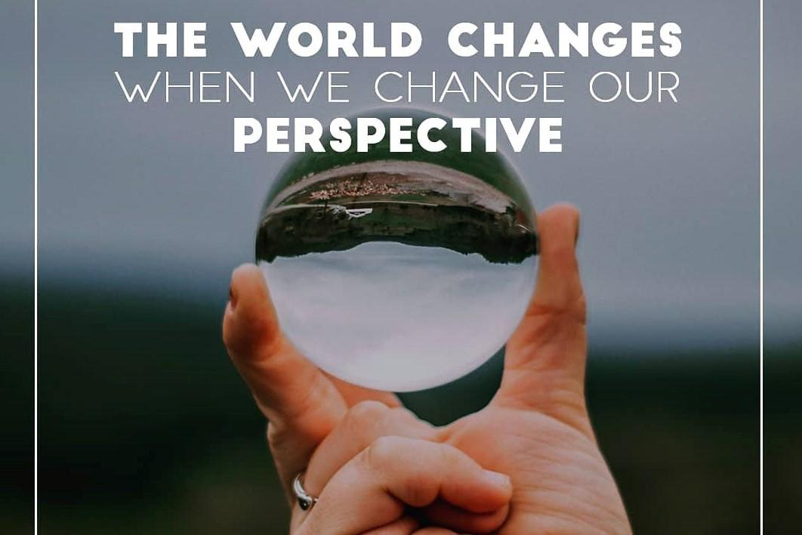
focus on global citizen education
to play an active and leading role in creating a better world

Slide 13
What is global citizenship education?
Global citizenship education was developed by the United Nations Educational, Scientific and Cultural Organization (UNESCO) as a response to challenges relating to human rights violations, inequality and poverty which all have an impact on peace and sustainability.
The goal of global citizenship education is to empower learners to engage and assume active roles, both locally and globally, to face and resolve global challenges

Slide 14
A global citizen is an agent of change and is able to:
Develop the knowledge, skills, and values they need to engage with the world
Understands and respects other perspectives, cultures and diversity
Believes that they can make a difference
Build their own understanding of world events
Think about their values and what is important to them
Take learning into the real world
Challenge ignorance and intolerance
Get involved in their local, national, and global communities
Develop an argument and voice their opinions
See that they have the power to act and influence the world around them
Inspire and informs others

Slide 15
Global Citizenship Education in the Classroom:
What does it look like?
Should global citizenship education be a separate subject?
We can considerate global citizenship education as a teaching framework that promotes core values related to non-discrimination, respect for diversity, solidarity, and humanity that, to work effectively within a school environment, needs to be incorporated into both the education policy and curriculum.
One of the most effective pedagogies for implementing global citizenship education is service-learning

Slide 16
To achieve this, service-learning makes use of the following teaching approaches:
Critical pedagogy – this form of experiential learning seeks to challenge inequality by confronting divisions created by race and class as well as by promoting equality and democracy through education. The basis of this approach is to get students to question existing structures, reflect on power and increase their critical consciousness
Transformative learning – service-learning is used to develop the conditions needed for transformative learning by creating ambiguity, dissonance, disorientation, and disequilibrium. Conditions can be created locally to reproduce a transformative immersion similar to an international experience
Reflective practice – is used to assist students in connecting local and global experiences, reflecting on their position in the world, their relationship to political and social institutions and to consider the role of community partners

Slide 17
From the above, it is clear that service-learning answers to the cognitive dimension of global citizenship education, as it challenges students to think differently in order to analyze sources of information and build their knowledge and critical thinking skills with a global view

